Slide 1
Collision Avoidance
Small Constituent Parts
Navigation through a corridor
Navigation around a corner
Using doors

Slide 2
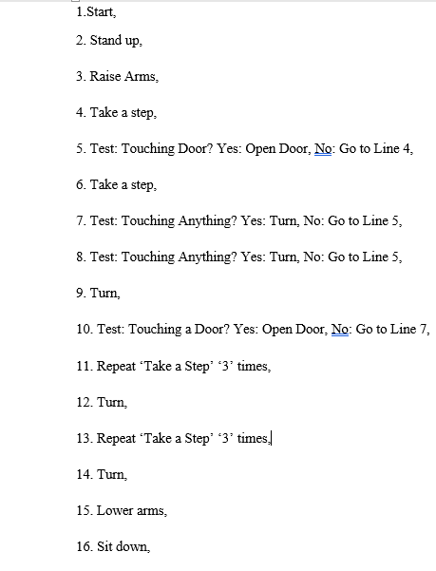
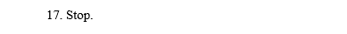

Slide 3
Navigation through a corridor
Navigation around a corner
Collision Avoidance
Using doors
Small Constituent Parts II
Program One: Turn Left
Program Two: Turn Right

Slide 4
Emphasis on the memory command
Irregular Shaped Maze:
Go beyond the obvious.
Doesn’t recognize his charging pad
Unable to know where he is in an unfamiliar maze
Using doors
Collison Avoidance
Otto Lab 1.
Small Constituent Parts:
Treat each environment Individually
*Touching anything? Test*
Solve Task 2 & 3

Slide 5
Step One:
Solve the most difficult task.
Obtain the commands to finish the easiest.
Set of commands:
Allow Otto to go through any maze.
Motivation: Going into a maze.
Otto Lab 2.
Otto’s definition of a door.
Always the same starting procedure
Small Constituent Parts:
Turn Left.
2) Turn Right.

Slide 6
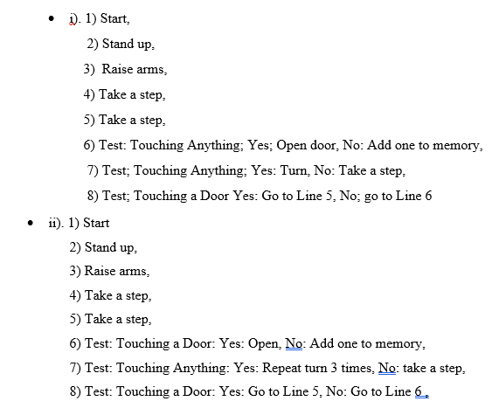
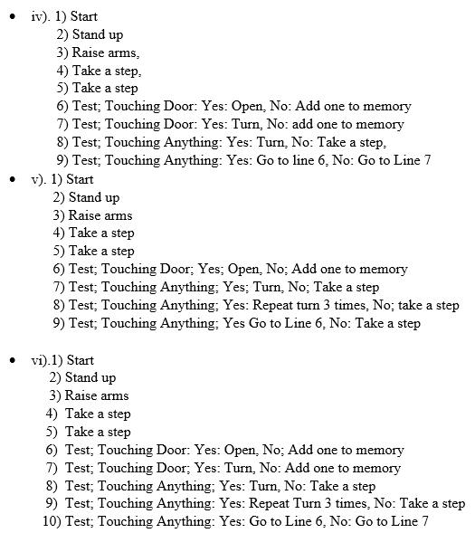
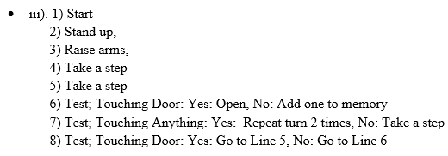

Slide 7
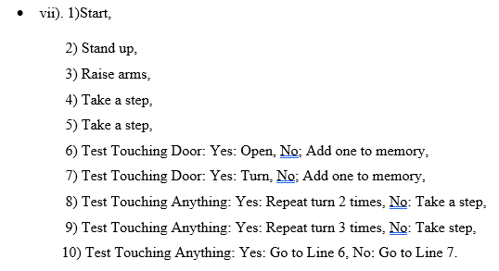
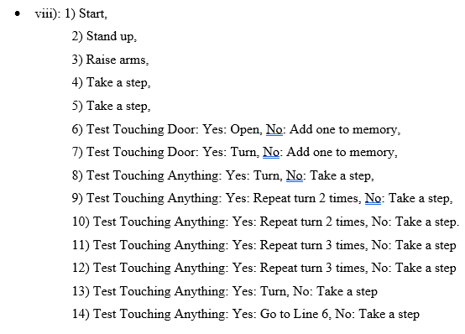
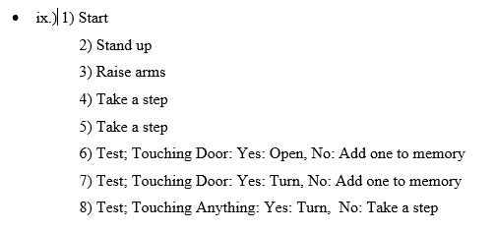

Slide 8
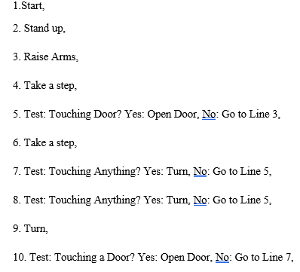
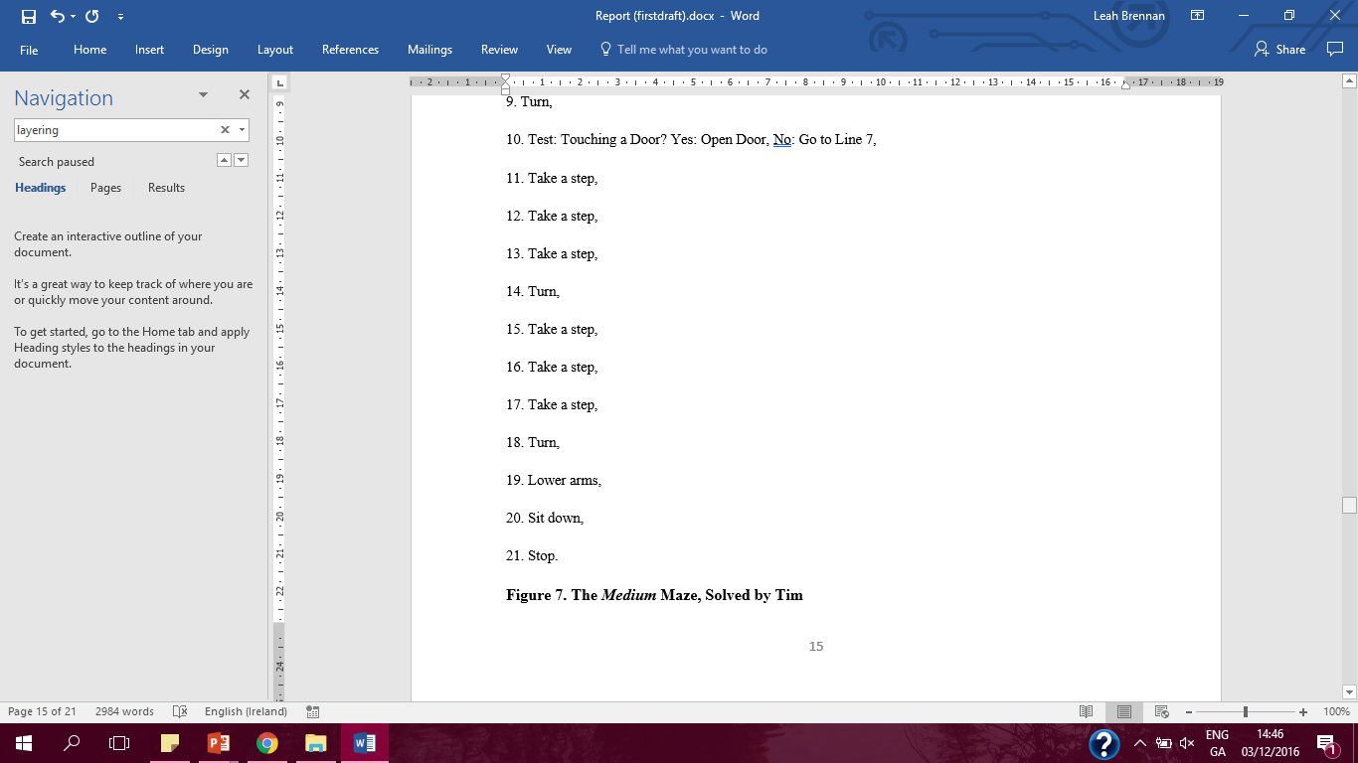

Slide 9
